Slide 1
Producing Quality Goods and Services

Slide 2
Learning Objectives
8-1 Explain the nature of production.
8-2 Outline how the conversion process transforms raw materials, labor, and other resources into finished goods or services.
8-3 Understand the importance of service businesses to consumers, other business firms, and the nation's economy.
8-4 Describe how research and development leads to new products and services.

Slide 3
Learning Objectives (continued)
8-5 Discuss the components involved in planning the production process.
8-6 Explain how purchasing, inventory control, scheduling, and quality control affect production.
8-7 Summarize how technology can make American firms more productive and competitive in the global marketplace.

Slide 4

What is Production?
Operations management: All the activities required to produce goods and services.
The operations manager manages systems that convert resources into goods and services
  Marketing research
  Planning
  Control operations
    Quality
    Performance
    Inventory
Notes:
Operations Management Professional Organizations
http://www.apics.org/
http://www.poms.org/

Slide 5
How American Manufacturers Compete in the Global Marketplace
From 1940s–1970s, the United States dominated global manufacturing
By late 1970s, Japan, Germany, Taiwan, Korea, Singapore, Sweden and others were competing
Notes:
Article
The Atlantic
Making it in America
Jan-Feb/2012
http://www.theatlantic.com/magazine/archive/2012/01/making-it-in-america/308844/

Slide 6
The Bad News for Manufacturers
Employment in the manufacturing sector has decreased.
  Outsourcing to low-wage workers in countries where regulations are lax
  Costs 20% more to manufacture in United States
  Decreased consumer demand for manufactured goods
9% of current U.S. workforce
7 million jobs lost since 1979
© JUSTASC/SHUTTERSTOCK

Slide 7
The Good News for Manufacturers
United States produces 18% of global manufacturing output
$2 trillion of U.S. economy
60% of U.S. exports
For every $1 spent in manufacturing, $1.35 is generated in the economy
Americans make more goods with fewer employees through innovation and elevated skill
Notes:
Table:
Selected Indexes of Manufacturing Activity by Country, 1990 – 2009
http://www.census.gov/compendia/statab/2012/tables/12s1353.pdf

Slide 8
Reshoring
Reshoring (aka onshoring or insourcing): U.S. manufacturers bringing jobs back to United States
  Increasing foreign labor costs
  High shipping costs
  Quality and safety issues
  Speed of product development
  Federal and state subsidies

Slide 9
Manufacturing: Elements of Success
The most successful U.S. firms focus on:
  Customer needs and product quality
  Employee motivation
  Supplier quality and prices
  High-tech, customizable manufacturing systems
  Lower costs through control procedures
  “Green” manufacturing
Notes:
The 2012 IndustryWeek U.S. 500
http://www.industryweek.com/resources/us500/2012

Slide 10
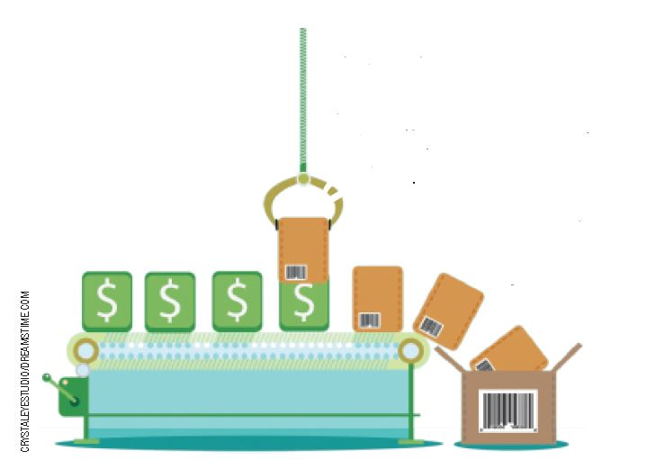
Careers in Operations Management
Operations managers need to understand:
  Mass production is a manufacturing process that lowers the cost required to produce a large number of identical or similar products over a long period
  An analytical process breaks raw materials into different component parts
  A synthetic process
  combines raw materials
  or components to create
  a finished product

Slide 11
Successful Operations Managers
Successful operations managers must:
  Be able to motivate and lead people
  Understand how technology can make a manufacturer more productive
  Appreciate the cost-control processes that help lower production costs and improve product quality
  Understand the relationship between the customer, the marketing of a product, and the production of a product

Slide 12
Utility
The purpose of manufacturing is to provide utility to customers
Utility is the ability of a good or service to satisfy a human need
  Form
  Place
  Time
  Possession
Form utility is created by people converting raw materials, finances, and information into finished products

Slide 13
The Conversion Process
The conversion process converts ideas and goods into useful goods and services
Conversion
Plan
Design
Execute
Evaluate
Improve
Redesign
Production Inputs
Outputs

Slide 14

Manufacturing Using a
Conversion Process
Focus: The resource(s) that make up the major or most important input
  Financial
  Material
  Information
  People
Magnitude of change: Degree to which the resources are physically changed
Number of production processes

Slide 15
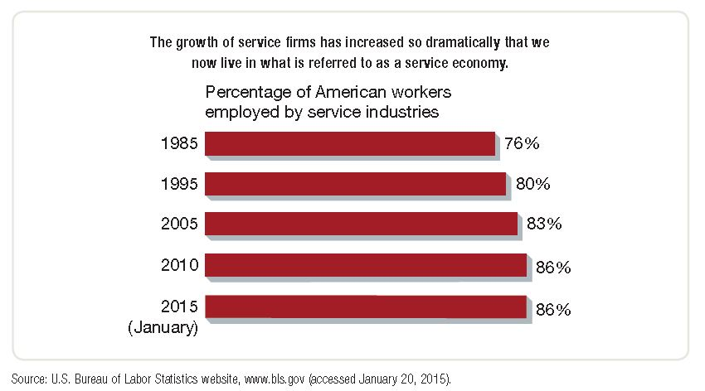
The Increasing Importance of Services
A service economy is one in which more effort is devoted to the production of services than the production of goods

Slide 16
The Increasing Importance of Services: Planning
Planning quality services:
  Begin with determining who the customer is and what they need
  Develop a plan that will enable the firm to deliver the services that their customers want or need
  Evaluate the way they operate and measure customer satisfaction
  Redesign their services to improve the customer’s experience

Slide 17
The Increasing Importance of Services:
Evaluating
Evaluating the quality of a firm’s services:
  The production of services varies from the
  production of manufactured goods:
    Customers are much more involved in obtaining the service they want or need
    Services are consumed immediately and cannot be stored
    Services are provided when and where the customer desires
    Services are usually labor intensive
    Services are intangible, making it difficult to evaluate customer satisfaction

Slide 18
The Service Process
Determine identity and needs of customer
Develop a plan to deliver services
Evaluate operating systems
Measure customer satisfaction
Redesign operating systems and services to improve the customer's experience
The Service Process

Slide 19
The Service Process: Evaluating Quality
Service firms often listen more carefully to customers and respond more quickly to changing needs
Consider:
What are some other examples of tools service firms can use to evaluate customer satisfaction and anticipate customer needs?
Is customer satisfaction more important in some industries than in others?
Notes:
Article
Pittsburgh Post-Gazette
Customer satisfaction just treading water
11/13/12
http://www.post-gazette.com/stories/business/news/customer-satisfaction-just-treading-water-661865/
Forbes
Customer Satisfaction By the Numbers: An Industry Breakdown
4/19/12
http://www.forbes.com/sites/ciocentral/2012/04/19/customer-satisfaction-by-the-numbers-an-industry-breakdown/
Report
J.D. Power and Associates
Understanding the Impact of Social Media on Companies
April 2012
https://pictures.dealer.com/jdpower/99ff6d760a0d02b7010f243b4bdcd474.pdf
Website
SurveyMonkey: Customer Satisfaction Surveys
http://www.surveymonkey.com/mp/customer-satisfaction-surveys/

Slide 20
New Products and Services:
Research and Development
A set of activities intended to identify new ideas that have the potential to result in new goods and services
Basic research: Uncovering new knowledge; scientific advancement without regard for its potential use
Applied research: Discovering new knowledge with some potential use
Development and implementation: Activities undertaken to put new or existing knowledge to use in producing goods and services
Notes:
Website
The New York Times Company Research and Development Lab
http://nytlabs.com/
IBM Journal of Research and Development
http://ieeexplore.ieee.org/xpl/RecentIssue.jsp?reload=true&punumber=5288520#
Dupont Research and Development
http://www2.dupont.com/inclusive-innovations/en-us/gss/science/technology.html
CNET Blog
Research and Development
http://news.cnet.com/8300-5_3-0.html?keyword=research+and+development

Slide 21

New Products and Services:
Product Extension and Refinement
Product refinement
  Improving a product’s performance characteristics
  to increase its utility to consumers
Product extension
  Improving and adding
  additional performance
  features that extend
  the want-satisfying
  capability of the
  product and its life
  cycle in the market

Slide 22
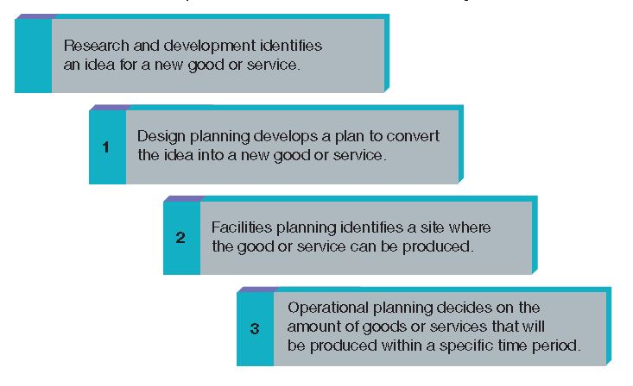
Planning for Production
Once research and development identifies an idea that meets customer needs, three additional steps are used to convert the idea to an actual good or service

Slide 23
Planning for Production:
Design Planning
Development of a plan for converting an idea into an actual product or service
Ask:
What will it look like?
Where and how will it be produced?
What options will be included?

Slide 24
Design Planning: Product Line
Group of similar products that differ only in relatively minor characteristics
Product lines must balance customer preferences and production requirements
Consider:
What are the benefits and drawbacks
of “long” and “short” product lines?

Slide 25
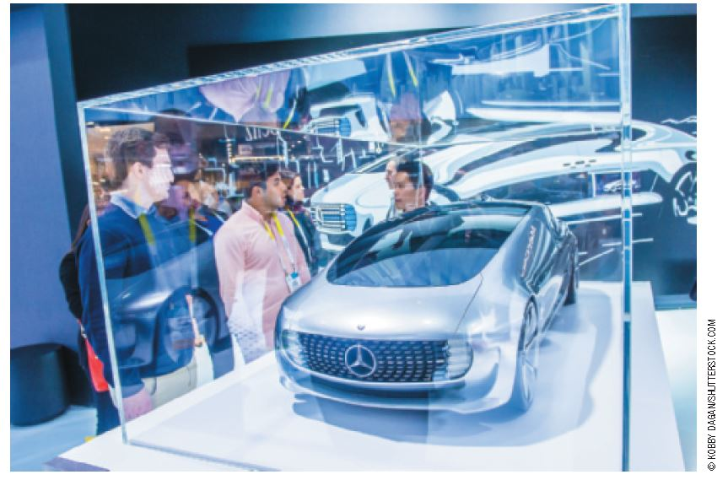
Design Planning: Product Design
Process of creating a set of specifications from which a product can be produced
The product design must be complete and detailed
Consider:
What is involved in the
product design of services?

Slide 26
Design Planning: Capacity
Amount of products or services that an
organization can produce in a given period of time
Operations managers determine capacity
Consider:
What happens if a firm overestimates capacity? Underestimates?
What can happen if a firm tries to increase
capacity without rethinking their line and design?
Notes:
Website
Houston Chronicle
What are Production Capacity Decisions?
http://smallbusiness.chron.com/production-capacity-decisions-43923.html
Article
Bloomberg
Toyota Says U.S. Pruis Supply to Recover to 70% in June
5/19/11
http://www.bloomberg.com/news/2011-05-19/toyota-says-u-s-prius-supply-to-recover-to-about-70-in-june.html

Slide 27
Design Planning:
Use of Technology
Labor-intensive technology
People do most of the work
Low initial cost
High operating cost
Capital-intensive technology
Machines do most of the work
High initial cost
Low operating cost

Slide 28
Site Selection and Facilities Planning
When deciding whether to produce a new product in an existing factory, a business asks:
Does the existing facility have the capacity to handle the increased demand for production?
Is the cost of refurbishing or expanding the existing facility less than constructing a new facility?

Slide 29
Location Considertations
Considerations in choosing a location:
      Location of customers and suppliers
      Availability and cost of labor
      Quality of life in the proposed location
      Cost of land and construction
      Taxes, regulations, and laws
      Financial support and subsidies
      Special resource requirements

Slide 30
Site Selection and Facilities Planning: Human Resources and Plant Layout
Human resources manager and operations manager must work together
  The appropriate skills must be identified
  Employees with the right skills must
  be recruited
  Training programs must be developed
  Compliance with human rights policies and wage laws must be ensured
Plant layout is the arrangement of machinery, equipment, and personnel within a production facility

Slide 31
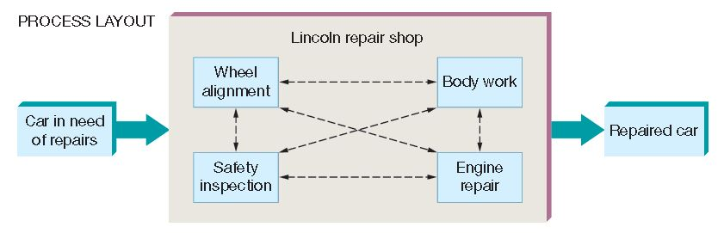
Process Layout
Process layout is used when small batches of different products are created or worked on in a different operating sequence

Slide 32
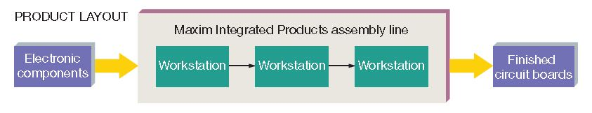
Product Layout
Product layout (assembly line) is used when all products undergo the same operations in the same sequence.

Slide 33
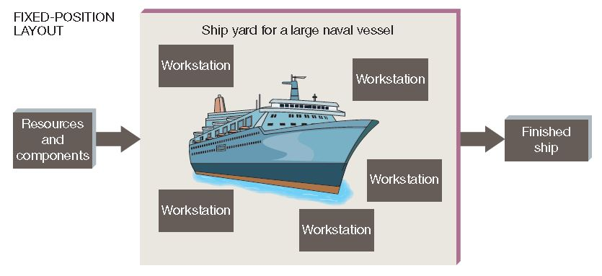
Fixed-Position Layout
Fixed-position layout is used in producing a product that is too large to move

Slide 34
Operational Planning
Four Steps In Operational Planning
Step 1: Selecting a planning horizon
  The period during which a plan will be in effect; commonly
  one year
Step 2: Estimating market demand
  The quantity that customers will purchase at the going price
  Demand is estimated for the planning horizon
Step 3: Comparing market demand with capacity
  If market demand and the facility’s capacity are not equal, adjustments may be necessary
Step 4: Adjusting products or services to meet demand
  Increase capacity to meet demand
  Ignore excess demand
  Eliminate excess capacity

Slide 35
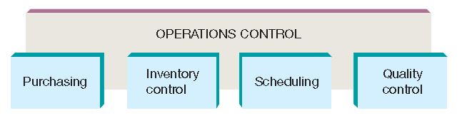
Operations Control
Implementing the operations control system in any business requires the effective use of:
  Purchasing
  Inventory control
  Scheduling
  Quality control

Slide 36
Operations Control: Purchasing
Ensure that required materials are available when they are needed, in the proper amounts, at a minimum cost
Choose suppliers based on:
  Price
  Quality
  Reliability
  Credit terms
  Shipping costs

Slide 37
Operations Control: Inventory Control
Process of managing inventories in such a way as to minimize inventory costs
  Holding cost: storage cost
  Stock-out cost: cost of running out of inventory
Raw-materials inventory
Work-in-progress inventory
Finished-goods inventory

Slide 38
Inventory Control:
Materials Requirement Planning (MRP)
MRP is a computerized system that integrates production planning and inventory control
Provides ability to juggle delivery schedules and lead times effectively
A manager using an MRP system can arrange both order and delivery schedules so that materials, parts, and supplies arrive when they are needed

Slide 39

Inventory Control:
Just-in-Time Inventory System
JIT ensures materials and supplies arrive at a facility just when they are needed so that storage and holding costs are minimized
Notes:
Article
Bloomberg Businessweek
The Downside of Just-in-Time Inventory
3/24/11

Slide 40
Operations Control: Scheduling
Process of ensuring that materials and other resources are at the right place at the right time
Routing: sequence of workstations
Timing: specifies when materials arrive at each station and how long they stay there
Follow-up: monitoring schedules to ensure that the work flows according to a timetable
Notes:
Video
I Love Lucy Candy Factory
http://www.youtube.com/watch?v=HnbNcQlzV-4

Slide 41
Operations Control: Quality Control
Process of ensuring that goods and services are produced in accordance with design specifics
Quality is an essential ingredient of goods and services
Defects decrease and profits increase
Reduces rework

Slide 42
Quality Control: Malcolm Baldrige National Quality Award
Given by the President of the United States to organizations judged to be outstanding in specific managerial tasks that lead to improved quality for products and services
Using the Baldrige criteria results in:
  Better employee relations
  Higher productivity
  Greater customer satisfaction
  Increased market share
  Improved profitability
Notes:
Website
Baldrige Performance Excellence Program
http://www.nist.gov/baldrige/

Slide 43
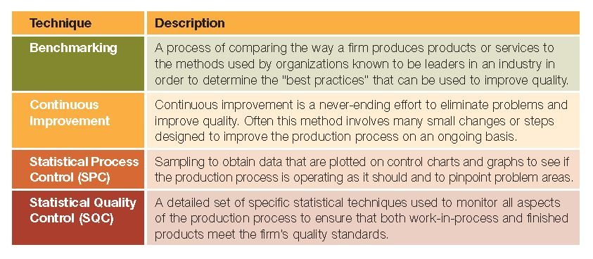
Techniques Used to Improve Quality
Notes:
There are several web-based sources of information and journals devoted to quality management and production issues.
National Association of Manufacturers: www.nam.org
Quality Digest: www.qualitydigest.com
Industry Week: http://www.industryweek.com

Slide 44
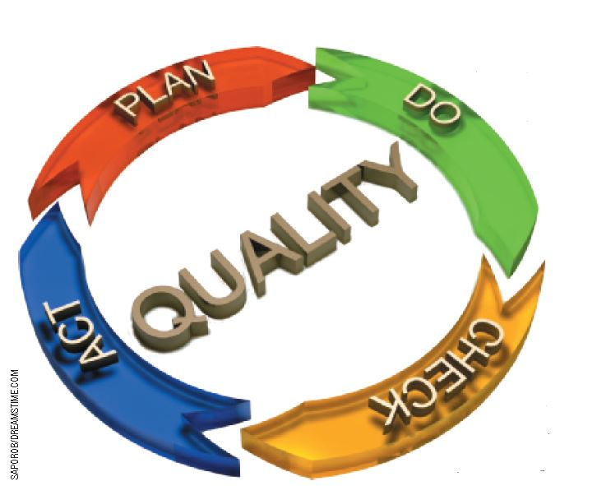
Quality Control: Employee Participation
Quality Circle: A team of employees who meet on company time to solve quality problems
Inspection: The examination of the quality of a work-in-progress
Six Sigma: A disciplined
approach that relies
on statistical data and
improved methods to
eliminate defects for a
firm’s products and
services

Slide 45
Quality Control:
Total Quality Management
TQM can be used to improve quality of a firm’s products and services
TQM
Customer Satisfaction
Employee Participation
Supplier Relationships
Atmosphere of Continuous Quality

Slide 46
Quality Control:
World Quality Standards
International Organization for Standardization (ISO): Network of national standards institutes and similar organizations from over 160 countries charged with developing standards for quality products
Standardization achieved through consensus agreements
Member organization for the United States: American National Standards Institute (Washington, D.C.)
Notes:
Website
ISO
http://www.iso.org/iso/home.htm

Slide 47
ISO 9000 and ISO 14000
ISO 9000—Certification for manufacturers and service providers based on quality
management in:
  Design
  Production Process
  Product Testing
ISO 14000—International standards for incorporating environmental concerns into operations and product standards

Slide 48
Class Exercise
Assume you are in charge of product development for a small manufacturing firm that produces three different sizes of paper clips.
What types of purchasing decisions would you need to make in order to manufacture these products?
How would you balance the problems of excessive holding costs and potential stock-out costs?
What specific steps would be used to manufacture a paper clip?
Should you be concerned with quality control for inexpensive products like paper clips?
Notes:
48

Slide 49
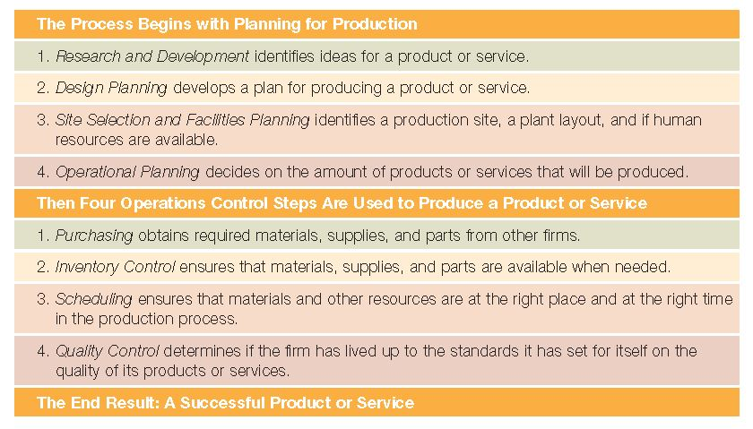
Production Planning: A Summary

Slide 50
Improving Productivity Growth
Productivity: Average level of output per worker per hour
Lean manufacturing: Eliminating waste from activities required to produce a product or service
  Reduction in resources required
  More efficient use of employee time
  Improved quality
  Increased profits

Slide 51
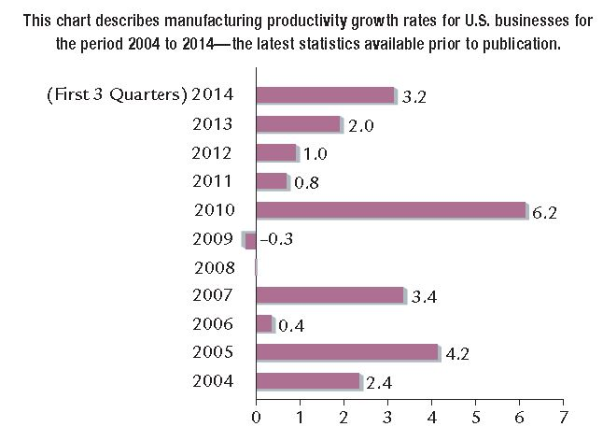
Productivity Growth Rates
Manufacturing productivity growth rates for U.S. businesses for 2004 to 2014
Source: Based on information in “Productivity Growth and Costs—Manufacturing 2014,” The Bureau of Labor Statistics website at www.bls.gov (accessed January 22, 2015).

Slide 52
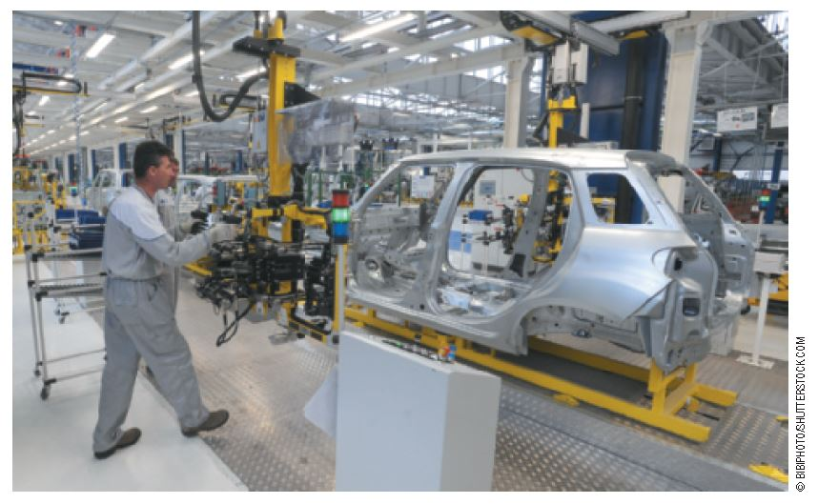
Impact of Automation, Robotics, and Computers on Productivity
Automation: The total or near total use of machines to do work
Robotics: The use of programmable machines to perform a variety of tasks by manipulating materials and tools
  Work quickly, accurately, and steadily
  Effective in tedious,
  repetitious, and
  hazardous tasks
Notes:
Article
NY Times
Skilled Work, Without the Worker
8/18/12
http://www.nytimes.com/2012/08/19/business/new-wave-of-adept-robots-is-changing-global-industry.html?pagewanted=all&_r=0
Bloomberg BusinessWeek
The March of Robots into Chinese Factories
11/29/12
http://www.businessweek.com/articles/2012-11-29/the-march-of-robots-into-chinese-factories

Slide 53
Computer Manufacturing Systems
Computer-aided design (CAD): the use of computers to aid in the development of products
Computer-aided manufacturing (CAM): The use of computers to plan and control manufacturing processes
Computer-integrated manufacturing (CIM)
CAD + CAM = CIM
  Improved flexibility
  More efficient scheduling
  Higher product quality

Slide 54
Flexible Manufacturing Systems
Traditional assembly lines require expensive
retooling of equipment when a new product is
introduced (continuous process)
Flexible manufacturing system (FMS) combines electronic machines and computer-integrated manufacturing in a single production system (intermittent process)
Customer-driven production is a manufacturing system driven by customer needs and what customers want to buy
Can customize manufacturing for each customer

Slide 55
Sustainability
Meeting the needs of the present without compromising the ability of future generations to meet their own needs
Resources are limited
Efforts to reduce waste and sustain the planet can improve profitability
© ALEXMILLOS/SHUTTERSTOCK
Notes:
Website
The Guardian Sustainable Business Awards
http://www.guardian.co.uk/sustainable-business/gsb-awards
Article
Fox Business
Unilever swaps earnings rat race for sustainability
http://www.foxbusiness.com/news/2012/11/02/interview-unilever-swaps-earnings-rat-race-for-sustainability/

Slide 56
Technological Displacement
© DVPODT/SHUTTERSTOCK
Automation cuts manufacturing time, reduces error, and simplifies retooling procedures
Many robots work with humans to make jobs safer and easier
Automation will bring change to many jobs; many workers will have to retrain or seek jobs in other sectors of the economy
Notes:
Article
PC Magazine
Techonomy: Can a Robot Steal Your Job?
11/13/12
http://forwardthinking.pcmag.com/none/304952-techonomy-can-a-robot-steal-your-job

